Slide 1

When Tables Finally Started Making Sense
A Deep Dive into Large Language Models, Data Querying, and the Shift from SQL to Natural Language.
VIJAYSHANKAR MISHRA | CMPE 255: Data Mining

Slide 2


The Data Mining Bottleneck
The Human Disconnect
The Structured Silo
Humans think and ask questions in Natural Language (e.g., "Who are our top customers?"). Bridging this gap has traditionally required manual translation by data analysts, creating a massive bottleneck in data exploration.
Organizations store vast amounts of knowledge in SQL databases and Data Warehouses. This data is structured, rigid, and requires specialized languages (SQL) to access.

Slide 3

The Evolution of
Text-to-SQL
From fragile rules to reasoning engines.

Slide 4

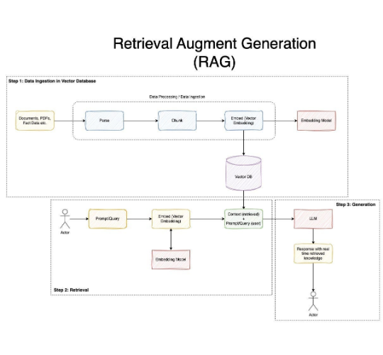
The Architecture
Modern Text-to-SQL isn't just translation; it's a multi-step pipeline powered by LLMs.
The system retrieves relevant table schemas, injects them into the prompt (Context), and uses the LLM's reasoning capabilities to generate syntactically correct SQL.
Key Concept: RAG (Retrieval Augmented Generation) ensures the model only sees relevant tables, reducing hallucinations.

Slide 5

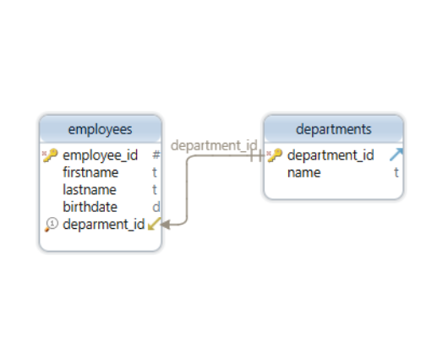
The Core Challenge: Schema Linking
The hardest part of Text-to-SQL is Schema Linking: connecting vague human words to precise database columns.
•
User says: "Revenue"
•
Database has: sales_amt, gross_income, total_rev
The model must infer that "Revenue" corresponds to sales_amt based on context and metadata, often using Foreign Key relationships to join tables correctly.

Slide 6




Ablation Insights: What Matters?
Foreign Keys
Schema Filtering
Reasoning Steps
Ablation studies show that explicitly providing Foreign Key constraints in the prompt boosts performance by ~15%. It helps the model understand how to JOIN tables.
Feeding the entire database schema confuses the LLM. "Schema Linking" pre-steps that filter out irrelevant tables are crucial for accuracy.
Chain-of-Thought (CoT) prompting, where the model explains its logic before writing SQL, significantly reduces logical errors in complex queries.

Slide 7
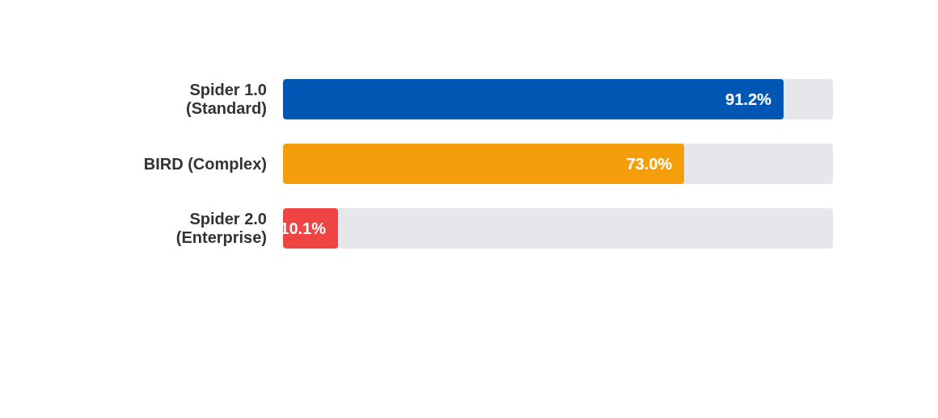
The Reality Check: Spider 1.0 vs 2.0
While LLMs have "solved" simple queries (Spider 1.0), they struggle massively with real-world enterprise workflows (Spider 2.0) involving massive schemas and nested logic.

Slide 8
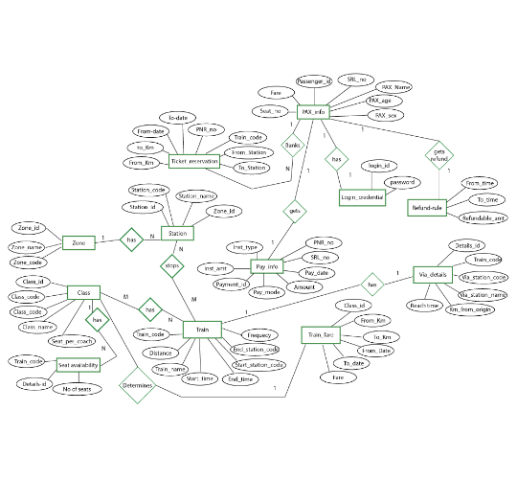
Why is Enterprise So Hard?
Enterprise data mining isn't just about `SELECT * FROM users`. It involves:
1. Scale: Databases with 3000+ columns. The schema alone exceeds the LLM's context window.
2. Ambiguity: "Churn" might be calculated differently by Sales vs. Marketing teams.
3. Dialects: Complex Snowflake or BigQuery specific syntax that standard training data misses.

Slide 9
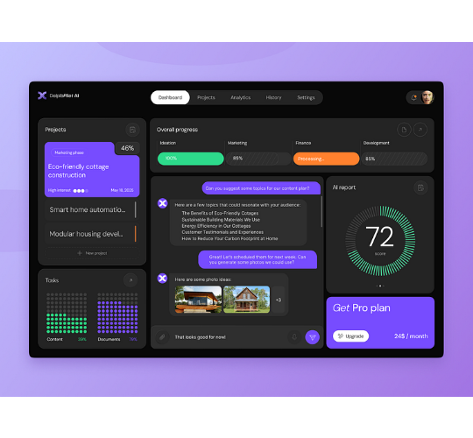
Future: Automated Data Agents
The future isn't just querying; it's full-stack Data Mining Agents.
Instead of just SQL, next-gen systems (Spider 2.0 focus) act as autonomous agents that can: Clean data, Run Python for advanced stats, and Generate Dashboards automatically.
We are moving from "Text-to-SQL" to "Text-to-Analysis".

Slide 10
Summary & Takeaways
The Breakthrough
The Frontier
LLMs have fundamentally changed how we interact with data, effectively acting as a universal compiler for human intent into machine code (SQL).
While basic translation is robust, the frontier lies in handling the messy reality of enterprise data—requiring better reasoning, context management, and agentic workflows.

Slide 11

Questions?
Thank you for your attention.
References:
1. "A Survey of Text-to-SQL in the Era of LLMs" (arXiv 2024)
2. Spider 2.0 Benchmark Results (2024)

Slide 12





Image Sources
https://miro.medium.com/0*7OaGfO2DctgswevJ.jpeg
Source: pub.towardsai.net
https://dbschema.com/blog/design/indexes-foreign-keys/foreign-key-2.png
Source: dbschema.com
https://cdn.nulab.com/learn-wp/app/uploads/2022/02/21193704/er-diagram-for-railway-reservation-system.png
Source: nulab.com
https://cdn.dribbble.com/userupload/42922211/file/original-f64607d002f236d28a28f632c2f6b403.png?resize=752x&vertical=center
Source: dribbble.com

